Slide 1
HPC Cloud Bad; HPC in the Cloud Good
Josh Simons, Office of the CTO, VMware, Inc.
IPDPS 2013
Cambridge, Massachusetts

Slide 2
Post-Beowulf Status Quo
Enterprise IT
HPC IT

Slide 3
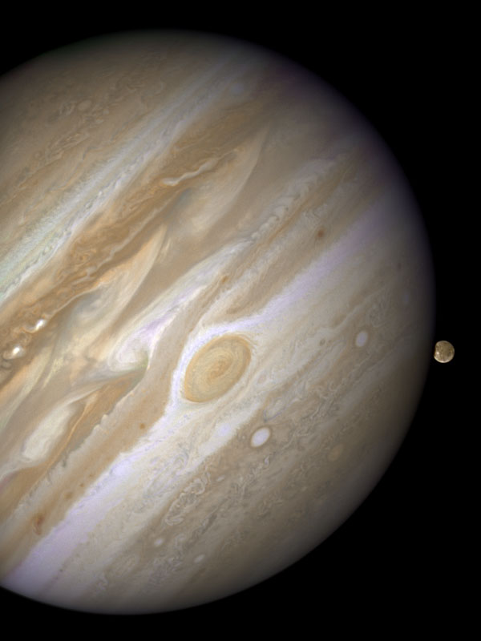
Closer to True Scale
(NASA)

Slide 4
Converging Landscape
Convergence driven by increasingly shared concerns, e.g.:
Enterprise IT
Scale-out management
Power & cooling costs
Dynamic resource mgmt
Desire for high utilization
Parallelization for multicore
Big Data Analytics
Application resiliency
Low latency interconnect
Cloud computing
HPC IT

Slide 5
Agenda
HPC and Public Cloud
  Limitations of the current approach
Cloud HPC Performance
  Throughput
  Big Data / Hadoop
  MPI / RDMA
HPC in the Cloud
  A more promising model

Slide 6
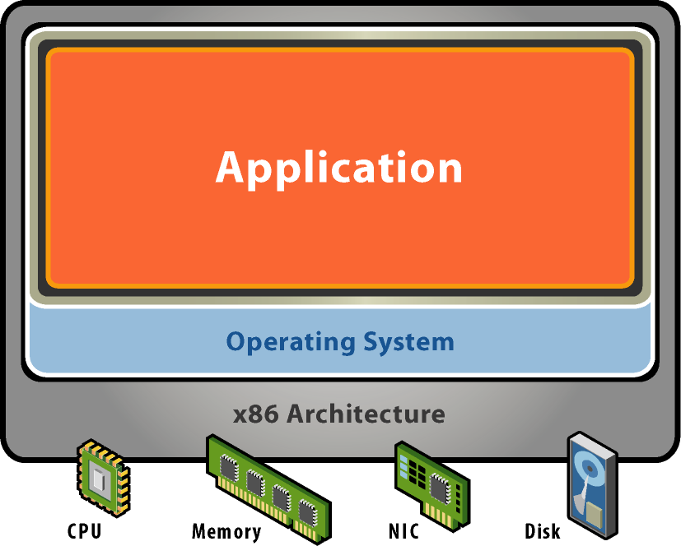
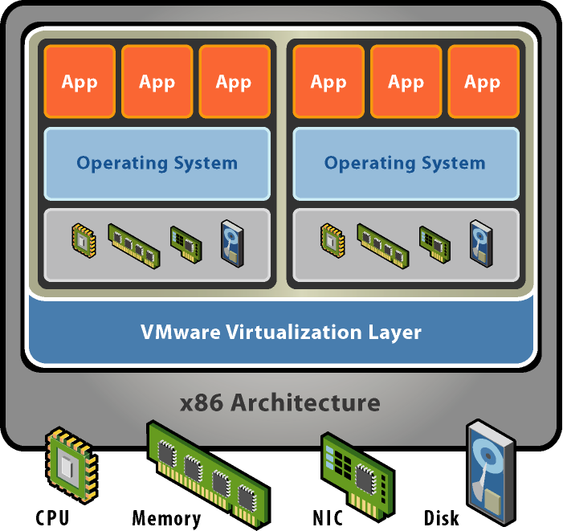
Server Virtualization
Without Virtualization
With Virtualization
Application
Operating System
Hardware
  Hardware virtualization presents a complete x86 platform to the virtual machine
  Allows multiple applications to run in isolation within virtual machines
  on the same physical machine
  Virtualization provides direct access to the hardware resources to give you much greater performance than software emulation
Notes:
6
Virtual machines are not a new concept. They were developed over thirty years ago for mainframe systems to allow multiple users to safely share those expensive machines. As computers became cheaper, the motivation behind virtualization faded and processor architectures like the Intel x86 were developed without some of the features needed to support virtualization.
VMware’s founders resurrected the virtual machine concept when problems like server proliferation and the need to run multiple applications in dedicated operating systems started becoming serious issues for IT managers and software developers. VMware developed revolutionary technology to efficiently virtualize x86 systems that,for the first time, allowed unmodified x86 operating systems and applications to run in true virtual machines with excellent performance.
Multiple virtual machines can operate concurrently on a single x86 host system. Each one can run a different operating system and application stack.
VMware’s virtualization technology provides each virtual machine with a true representation of an x86 computer, complete with processor, memory, networking interfaces and storage devices. The VMware virtualization layer gives the virtual machines direct access to the underlying x86 hardware – an important distinction from the much slower emulation technology that must process all virtual machine operations in software.

Slide 7
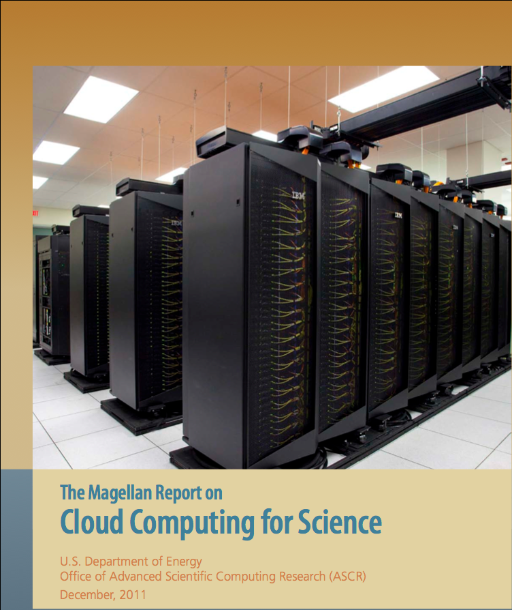
HPC Performance in the Cloud
http://science.energy.gov/~/media/ascr/pdf/program-documents/docs/Magellan_final_report.pdf

Slide 8
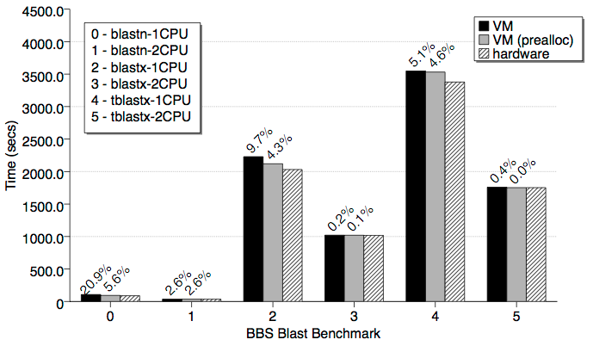
Biosequence Analysis: BLAST
C. Macdonell and P. Lu, "Pragmatics of Virtual Machines for High-Performance Computing: A Quantitative Study of Basic Overheads, " in Proc. of the High Perf. Computing & Simulation Conf., 2007.

Slide 9
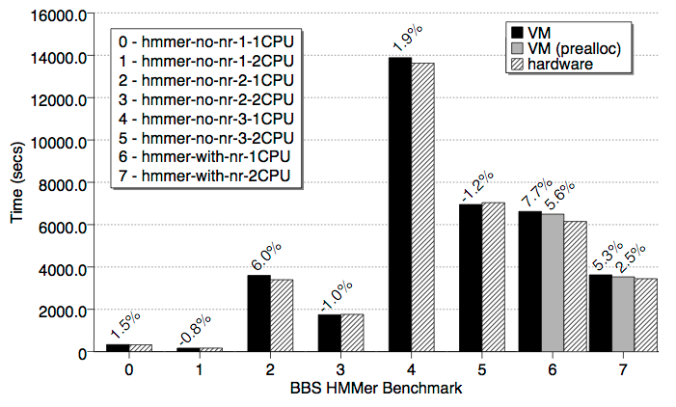
Biosequence Analysis: HMMer

Slide 10
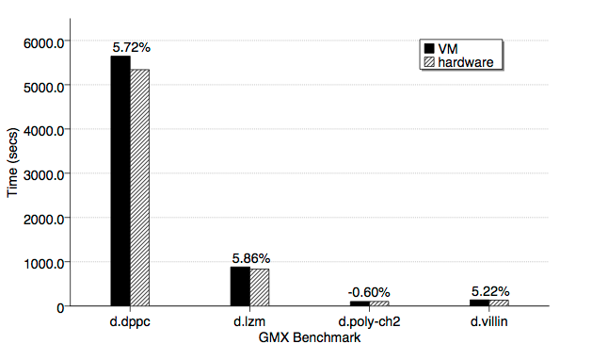
Molecular Dynamics: GROMACS

Slide 11
EDA Workload Example
operating system
OS
OS
OS
OS
app
app
app
app
app
app
app
app
virtualization layer
hardware
hardware
Virtual 6% slower
Virtual 2% faster

Slide 12
Memory Virtualization
HPL | Native | Virtual
 |  | EPT on | EPT off
4K pages | 37.04 GFLOPS | 36.04 (97.3%) | 36.22 (97.8%)
2MB pages | 37.74 GLFLOPS | 38.24 (100.1%) | 38.42 (100.2%)
virtual
physical
*RandomAccess | Native | Virtual
 |  | EPT on | EPT off
4K pages | 0.01842 | 0.0156 (84.8%) | 0.0181 (98.3%)
2MB pages | 0.03956 | 0.0380 (96.2%) | 0.0390 (98.6%)
machine
EPT = Intel Extended Page Tables = hardware page table virtualization = AMD RVI
Notes:
Briefly describe three-level memory hierarchy in virtual world and then discuss the differences shown here between a benchmark with good memory locality (LINPACK) and one with no locality whatsoever (StarRandomAccess – represents an NSA workload). The point illustrated here is that while EPT very often works well, there may be (important) cases in which it does not. In such cases, use of shadow page tables actually increases performance (as does use of large pages).

Slide 13
vNUMA
Application
ESXi hypervisor
M
M
M
socket
socket
M
socket
socket

Slide 14
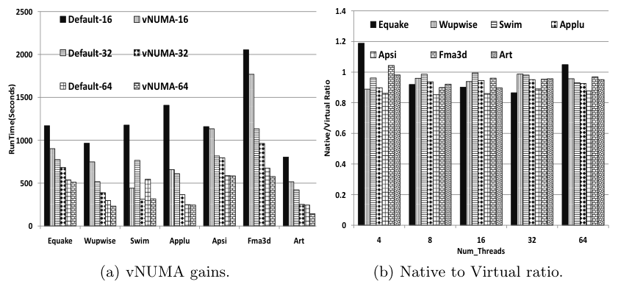
vNUMA Performance Study
Performance Evaluation of HPC Benchmarks on VMware’s ESX Server, Ali Q., Kiriansky, V., Simons J., Zaroo, P., 5th Workshop on System-level Virtualization for High Performance Computing, 2011
Notes:
Discuss results. Left side shows performance improvements with vNUMA. Right side shows improvements bring performance in-line with native performance. Note, too, that these graphs show vCPU scalability to 64.

Slide 15
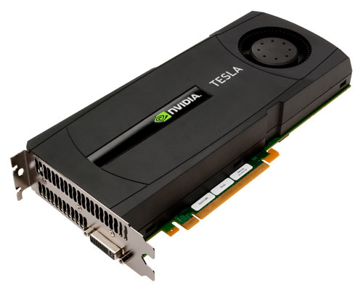
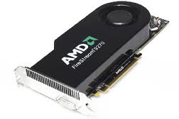
Compute: GPGPU Experiment
General Purpose (GP) computation with GPUs
CUDA benchmarks
VM Direct Path I/O
Small kernels: DSP, financial,
bioinformatics, fluid dynamics,
image processing
RHEL 6
nVidia (Quadro 4000) and AMD GPUs
Generally 98%+ of native performance
(worst case was 85%)
Currently looking at larger-scale financial
and bioinformatics applications

Slide 16
MapReduce Architecture
HDFS
HDFS
MAP
Reduce
MAP
Reduce
MAP
Reduce
MAP
Notes:
Interest in virtualizing Hadoop clusters -- to incorporate into existing VMware environments (presumably most of the customers in the room are already using VMware). Briefly describe the model to set context for next slide.

Slide 17
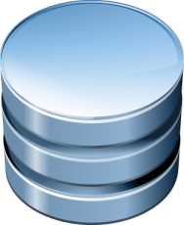
vHadoop Approaches
M
M
R
R
M
M
R
VM
VM
VM
VM
Why virtualize Hadoop?
  Simplified Hadoop cluster configuration and provisioning
  Support Hadoop usage in existing virtualized datacenters
  Support multi-tenant environments
  Project Serengeti
Node
Node
Node
HDFS
Compute Node
CN
R
M
R
Data Node
Node
Notes:
Bare metal Hadoop. HDFS is built from local disks and includes redundancy for fault tolerance and performance.

Slide 18
vHadoop Benchmarking Collaboration with AMAX
Seven-node Hadoop cluster (AMAX ClusterMax)
Standard tests: PI, DFSIO, Teragen / Terasort
Configurations:
  Native
  One VM per host
  Two VMs per host
Details:
  Two-socket Intel X5650, 96 GB, Mellanox 10 GbE, 12x 7200rpm SATA
  RHEL 6.1, 6- or 12-vCPU VMs, vmxnet3
  Cloudera CDH3U0, replication=2, max 40 map and 10 reduce tasks per host
    Each physical host considered a “rack” in Hadoop’s topology description
  ESXi 5.0 w/dev Mellanox driver, disks passed to VMs via raw disk mapping (RDM)

Slide 19
Benchmarks
Pi
  Direct-exec Monte-Carlo estimation of pi
  # map tasks = # logical processors
  1.68 T samples
TestDFSIO
  Streaming write and read
  1 TB
  More tasks than processors
Terasort
  3 phases: teragen, terasort, teravalidate
  10B or 35B records, each 100 Bytes (1 TB, 3.5 TB)
  More tasks than processors
  CPU, networking, and storage I/O
π ~ 4*R/(R+G) = 22/7

Slide 20
Ratio to Native, Lower is Better
A Benchmarking Case Study of Virtualized Hadoop Performance on VMware vSphere 5
http://www.vmware.com/files/pdf/VMW-Hadoop-Performance-vSphere5.pdf

Slide 21
Kernel Bypass Model
application
application
user
user
sockets
rdma
sockets
rdma
rdma
kernel
guest kernel
tcp/ip
tcp/ip
driver
driver
vmkernel
rdma
hardware
hardware

Slide 22
Virtual Infrastructure RDMA
Distributed services within the platform, e.g.
  vMotion (live migration)
  Inter-VM state mirroring for fault tolerance
  Virtually shared, DAS-based storage fabric
All would benefit from:
  Decreased latency
  Increased bandwidth
  CPU offload

Slide 23
vMotion/RDMA Performance
Total vMotion Time (sec)
Pre-copy bandwidth (Pages/sec)
Time (s)
Time (s)
Destination CPU Utilization
Source CPU Utilization

Slide 24
Guest OS RDMA
RDMA access from within a virtual machine
Scale-out middleware and applications increasingly important in the Enterprise
  memcached, redis, Cassandra, mongoDB, …
  GemFire Data Fabric, Oracle RAC, IBM pureScale, …
Big Data an important emerging workload
  Hadoop, Hive, Pig, etc.
And, increasingly, HPC

Slide 25
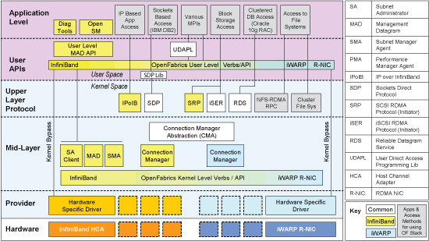

SR-IOV VirtualFunction VM DirectPath I/O
Single-Root IO Virtualization (SR-IOV): PCI-SIG standard
Physical (IB/RoCE/iWARP) HCA can be shared between VMs or by the ESXi hypervisor
  Virtual Functions direct assigned to VMs
  Physical Function controlled by hypervisor
Still VM DirectPath, which is incompatible with several important virtualization features
Guest OS
Guest OS
Guest OS
OFED Stack
RDMA HCA
VF Driver
RDMA HCA
VF Driver
OFED Stack
OFED Stack
RDMA HCA
VF Driver
RDMA HCA
VF Driver
RDMA HCA
VF Driver
Virtualization
Layer
PF Device
Driver
I/O MMU
VF
VF
VF
SR-IOV
RDMA HCA
PF

Slide 26

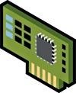
Paravirtual RDMA HCA (vRDMA) offered to VM
New paravirtualized device exposed to Virtual Machine
  Implements “Verbs” interface
Device emulated in ESXi hypervisor
  Translates Verbs from Guest to Verbs to ESXi “OFED Stack”
  Guest physical memory regions mapped to ESXi and passed down to physical RDMA HCA
  Zero-copy DMA directly from/to guest physical memory
  Completions/interrupts “proxied” by emulation
“Holy Grail” of RDMA options for vSphere VMs
OFED Stack
Guest OS
vRDMA HCA Device Driver
vRDMA Device Emulation
I/O Stack
ESXi “OFED Stack”
Physical RDMA HCA
Device Driver
Physical RDMA HCA

Slide 27
InfiniBand Bandwidth with VM DirectPath I/O
RDMA Performance in Virtual Machines using QDR InfiniBand on VMware vSphere 5, April 2011
http://labs.vmware.com/academic/publications/ib-researchnote-apr2012

Slide 28
Latency with VM DirectPath I/O (RDMA Read, Polling)
MsgSize (bytes) | Native | ESXi ExpA
2 | 2.28 | 2.98
4 | 2.28 | 2.98
8 | 2.28 | 2.98
16 | 2.27 | 2.96
32 | 2.28 | 2.98
64 | 2.28 | 2.97
128 | 2.32 | 3.02
256 | 2.5 | 3.19

Slide 29
Latency with VM DirectPath I/O (Send/Receive, Polling)
MsgSize (bytes) | Native | ESXi ExpA
2 | 1.35 | 1.75
4 | 1.35 | 1.75
8 | 1.38 | 1.78
16 | 1.37 | 2.05
32 | 1.38 | 2.35
64 | 1.39 | 2.9
128 | 1.5 | 4.13
256 | 2.3 | 2.31

Slide 30
Intel 2009 Experiments
Hardware
  Eight two-socket 2.93GHz X5570 (Nehalem-EP) nodes, 24 GB
  Dual-ported Mellanox DDR InfiniBand adaptor
  Mellanox 36-port switch
Software
  vSphere 4.0 (current version is 5.1)
  Platform Open Cluster Stack (OCS) 5 (native and guest)
  Intel compilers 11.1
  HPCC 1.3.1
  STAR-CD V4.10.008_x86

Slide 31
HPCC Virtual to Native Run-time Ratios (Lower is Better)
Data courtesy of:
Marco Righini
Intel Italy

Slide 32
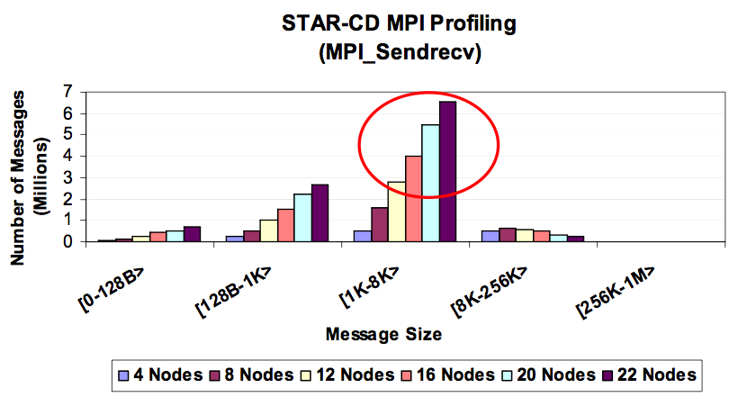
Point-to-point Message Size Distribution: STAR-CD
Source: http://www.hpcadvisorycouncil.com/pdf/CD_adapco_applications.pdf

Slide 33
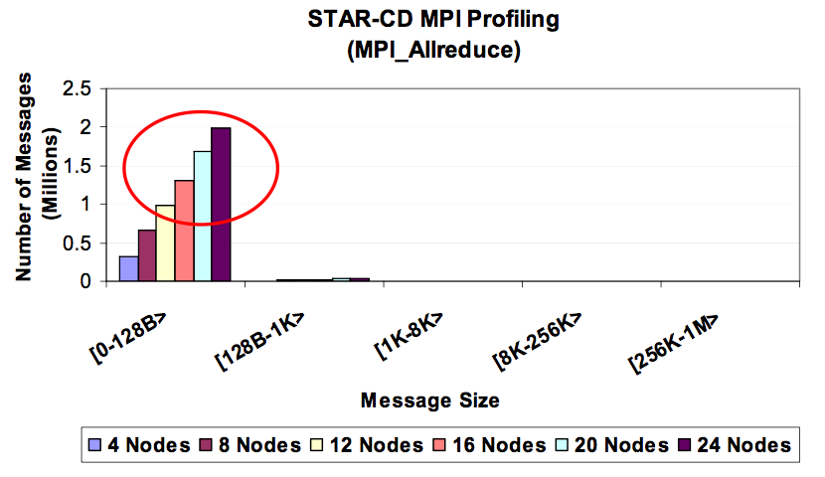
Collective Message Size Distribution: STAR-CD
Source: http://www.hpcadvisorycouncil.com/pdf/CD_adapco_applications.pdf

Slide 34
STAR-CD Virtual to Native Run-time Ratios (Lower is Better)
Data courtesy of Marco Righini, Intel Italy

Slide 35













Software Defined Networking (SDN) Enables Network Virtualization
650.555.1212
Telephony
Wireless
Telephony
Identifier = Location
650.555.1212
192.168.10.1
192.168.10.1
Networking
VXLAN
Identifier = Location

Slide 36



Data Center Networks – Traffic Trends
WAN/Internet
NORTH / SOUTH
EAST / WEST

Slide 37

Data Center Networks – the Trend to Fabrics
WAN/Internet
WAN/Internet
Notes:
From 2- or 3-tier to spine/leaf
Density & bandwidth jump
ECMP for layer 3 (and layer 2)
Reduce network oversubscription
Wire & configure once
Uniform configurations

Slide 38
Network Virtualization and RDMA
SDN
  Decouple logical network from physical hardware
    Encapsulate Ethernet in IP → more layers
  Flexibility and agility are primary goals
RDMA
  Directly access physical hardware
    Map hardware directly into userspace → fewer layers
  Performance is primary goal
Is there any hope of combining the two?
  Converged datacenter supporting both SDN management and decoupling along with RDMA

Slide 39













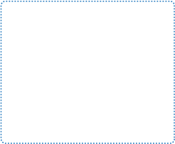
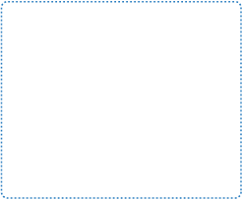




Secure Private Cloud for HPC
Research Group 1
Research Group m
Users
IT
VMware vCloud Director
Public Clouds
User Portals
Catalogs
Security
VMware vCloud API
Research Cluster 1
Research Cluster n
VMware
vShield
Programmatic
Control and
Integrations
VMware
vCenter Server
VMware
vCenter Server
VMware
vCenter Server
VMware vSphere
VMware vSphere
VMware vSphere

Slide 40
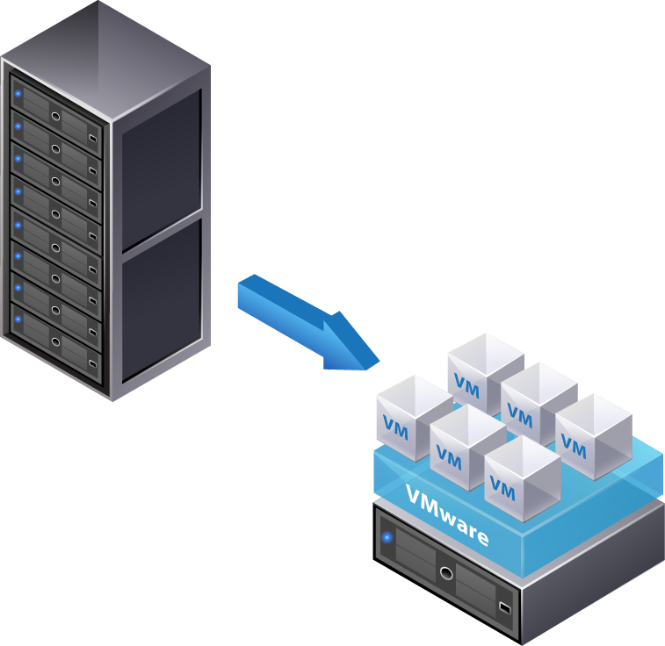
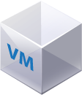
Massive Consolidation

Slide 41
Run Any Software Stacks
Support groups with disparate software requirements
Including root access
App A
App B
OS A
OS B
virtualization layer
virtualization layer
virtualization layer
hardware
hardware
hardware

Slide 42
Separate workloads
Secure multi-tenancy
Fault isolation
…and sometimes performance
App A
App B
OS A
OS B
virtualization layer
virtualization layer
virtualization layer
hardware
hardware
hardware

Slide 43
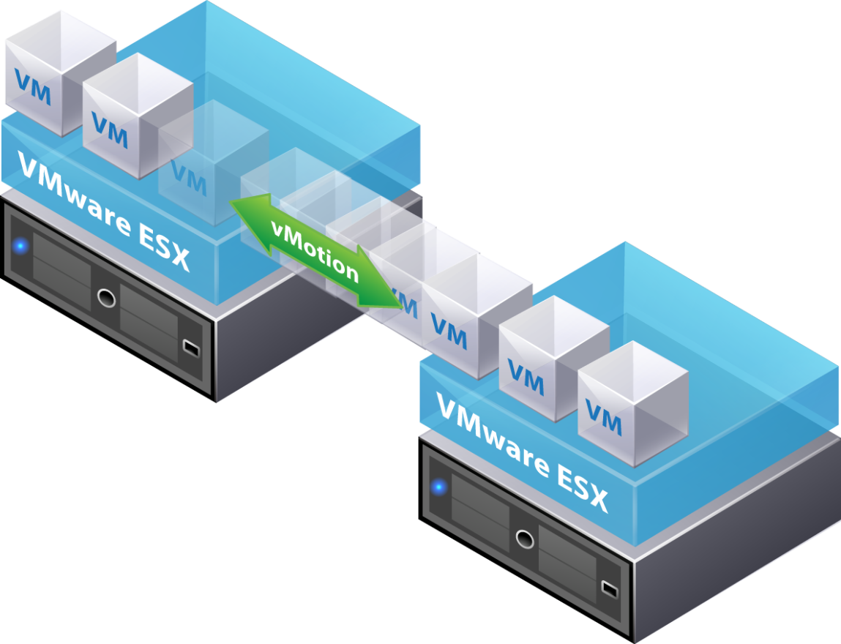
Live Virtual Machine Migration (vMotion)

Slide 44
Use Resources More Efficiently
Avoid killing or pausing jobs
Increase overall throughput
App C
OS A
App A
App B
App A
App C
OS A
OS B
OS A
OS B
virtualization layer
virtualization layer
virtualization layer
hardware
hardware
hardware

Slide 45
Workload Agility
app
app
app
operating system
app
app
app
virtualization layer
virtualization layer
hardware
hardware
hardware

Slide 46
Multi-tenancy with resource guarantees
Define policies to manage resource sharing between groups
App A
App B
App C
App A
App B
App A
App C
OS A
OS B
OS A
OS A
OS B
OS A
OS B
virtualization layer
virtualization layer
virtualization layer
hardware
hardware
hardware

Slide 47
Protect Applications from Hardware Failures
Reactive Fault Tolerance: “Fail and Recover”
App A
App A
OS
OS
virtualization layer
virtualization layer
virtualization layer
hardware
hardware
hardware

Slide 48
Protect Applications from Hardware Failures
Proactive Fault Tolerance: “Move and Continue”
MPI-0
MPI-1
MPI-2
OS
OS
OS
virtualization layer
virtualization layer
virtualization layer
hardware
hardware
hardware

Slide 49
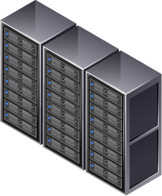
Unification of IT Infrastructure

Slide 50
HPC in the (Mainstream) Cloud
MPI / RDMA
Throughput

Slide 51
Summary
HPC Performance in the Cloud
  Throughput applications perform very well in virtual environments
  MPI / RDMA applications will experience small to very significant slowdowns in virtual environments, depending on scale and message traffic characteristics
Enterprise and HPC IT requirements are converging
  Though less so with HEC (e.g. Exascale)
Vendor and community investments in Enterprise solutions eclipse those made in HPC due to market size differences
  The HPC community can benefit significantly from adopting Enterprise-capable IT solutions
  And working to influence Enterprise solutions to more fully address HPC requirements
Private and community cloud deployments provide significantly more value than cloud bursting from physical infrastructure to public cloud

